Slide 1
Laker Legacies
Daniel Newell, Nicholas Workman, Thomas Peterson

Slide 2
Project Specs
GVSU "Philanthropy Tour" Application
Give users a chance to learn about the individuals many of the buildings on campus are named for.
Inspire the user to further research the "Laker for a Lifetime" initiative
Allow the application to be interactive with the location of the user

Slide 3
Project Specs Continued
Functional Iphone app ready to launch by the start of spring / summer session
Target iOS 5.0 and up
Be visually appealing
Utilize the latest user interface conventions on the iOS platform

Slide 4
Layout and Functionality
Seven Different Screens
Home Page
Directory View
Detailed View
Map View
Near Me View
Bonus Functionality Page
Embedded donation page
Each screen has a separate unique functionality that enhances the usability of the application.

Slide 5
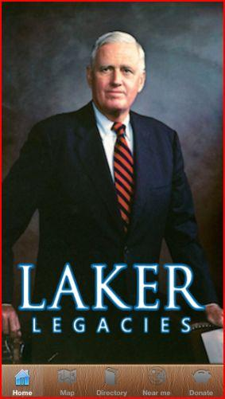
Home Page
Simple and Sleek
Rotating Picture Slideshow
Five tab navigation
Opening page of the application

Slide 6
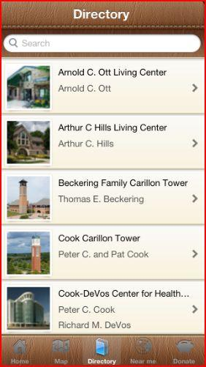
Directory View
Organized Alphabetically
Thumbnail Image
Name of building & Donor
Center Tab on the Nav bar

Slide 7
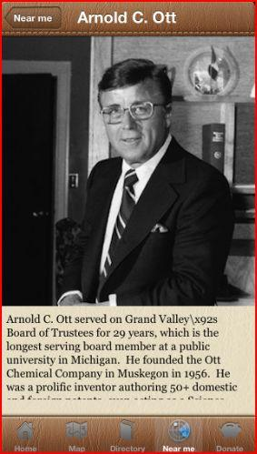
Detail View
Most Important View
Top Title
Back Button in top left
Information below image

Slide 8
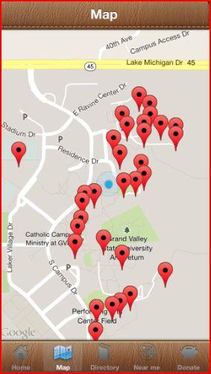
Map View
User Pin
Building Pins
When one building is selected the name of the building appears above in a message box.

Slide 9
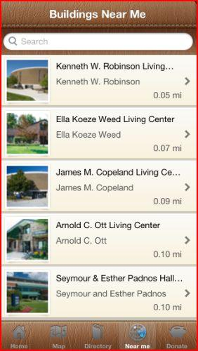
Near Me View
Similar to directory View
Distance to user located in bottom left
Thumbnail image as well as building and donor name

Slide 10
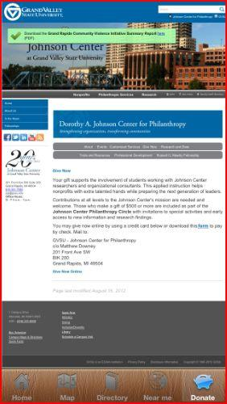
Embedded Donation Page
Embedded Grand Valley's donation page directly into the application
Ensures Grand Valley has complete control of how money is donated to the university.

Slide 11
Learning Difficulties
Learning xcode
How to manage git
Development style
Storyboards vs backend + xib files
Choosing how to store the data
Core data vs Plist
Map Style
Apple Maps vs Google Maps

Slide 12
Keep users coming back
From the very start we realized that our target audience was fairly small
So what was our secret weapon to help make the app stay relevant?
Great style / Keeping the app clean

Slide 13
Future Goals
Google maps turned out to be a great route
But the "window" isn't customizable yet
When the new releases come out this will be at the top our list to update
Updating to Retna
As of 5/13/2013 all apps released to the app store must support it
Better Donation system
Legalities with crediting payments make it hard to take money within the app

Slide 14
Questions?

